Slide 1


YOUR PERFORMANCE MARKETING PARTNER
KODE
ACADEMY
ARCHITECTURE & DATA FLOW
Understanding frontend pain in 3 languages … and 1 library
Dominique VASSARD // Developer

Slide 2
Introduction
About choosing a frontend framework
Choosing a frontend framework is not just about WHAT we can do with it
But also HOW we want to develop with it

Slide 3
Introduction
About choosing a frontend framework
Structure
Code safety
Maintainability
Scalability

Slide 4




Introduction
About choosing a frontend framework
3 languages and 1 library:
+ (Javascript + React)
+ (Reason + React)
(Elm)

Slide 5
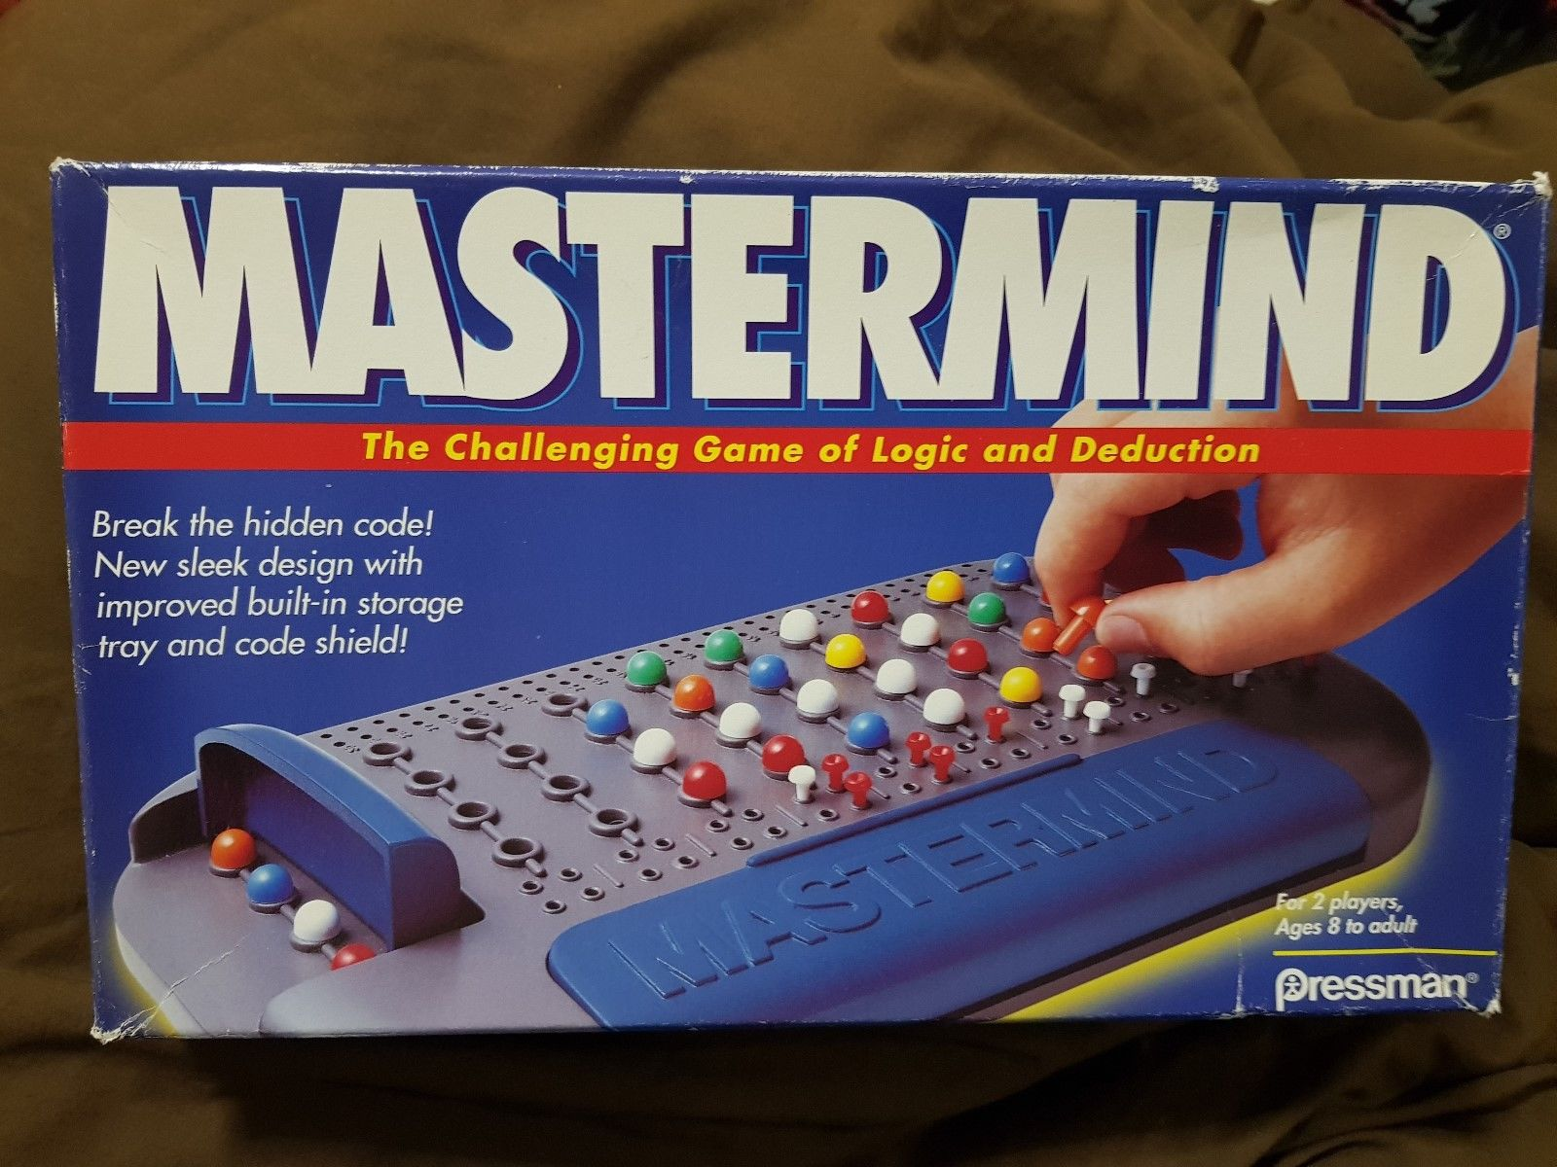
Introduction
About choosing a frontend framework

Slide 6
Javascript + React

Slide 7
React History
React:
Created by Jordan Walke (Facebook)
Born in 2012
Open sourced in 2013
Current version: 16.3.2 (2018/04/16)

Slide 8
React: Overview of novelties
COMPONENT:
Think in small component, not big pages
Smaller scope / concern, better understanding
Reusability
Not really new (Web component, Polymer, etc.)

Slide 9
React: Overview of novelties
VIRTUAL DOM:
DOM abstraction
Allow fast / easy DOM updates

Slide 10
React: Overview of novelties
STATEFUL / STATELESS COMPONENTS:
Manages states only where it’s necessary
Avoid scope / state mess
Think about your data!

Slide 11
React: Overview of novelties
Stateful Component
props
props
Stateless Component
Stateless Component
props
Stateless Component

Slide 12
React: Overview of novelties
MVC IS DEAD!
Model
Controller
View
Events

Slide 13
React: Overview of novelties
External data
Stateful Component
Event
props
props
Stateless Component
Stateless Component
Event
props
Event
Stateless Component

Slide 14
React: Overview of novelties
OH WAIT...

Slide 15
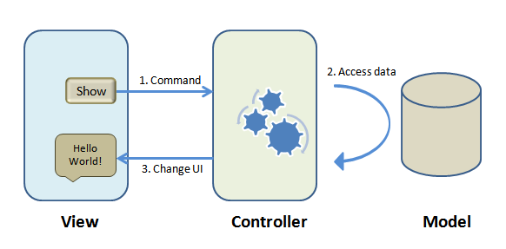
React: Overview of novelties

Slide 16
React: Overview of novelties
Model
Controller
External Data
Stateful Component
Event
props
props
Stateless Component
Stateless Component
Event
Event
View
props
Stateless Component

Slide 17
React: Overview of novelties
FUNCTIONAL FLAVOUR:
State should be immutable
Stateless component are functions, stateful component are classes
You can even write all your fronted without classes (with Recompose)

Slide 18
React Mastermind

Slide 19
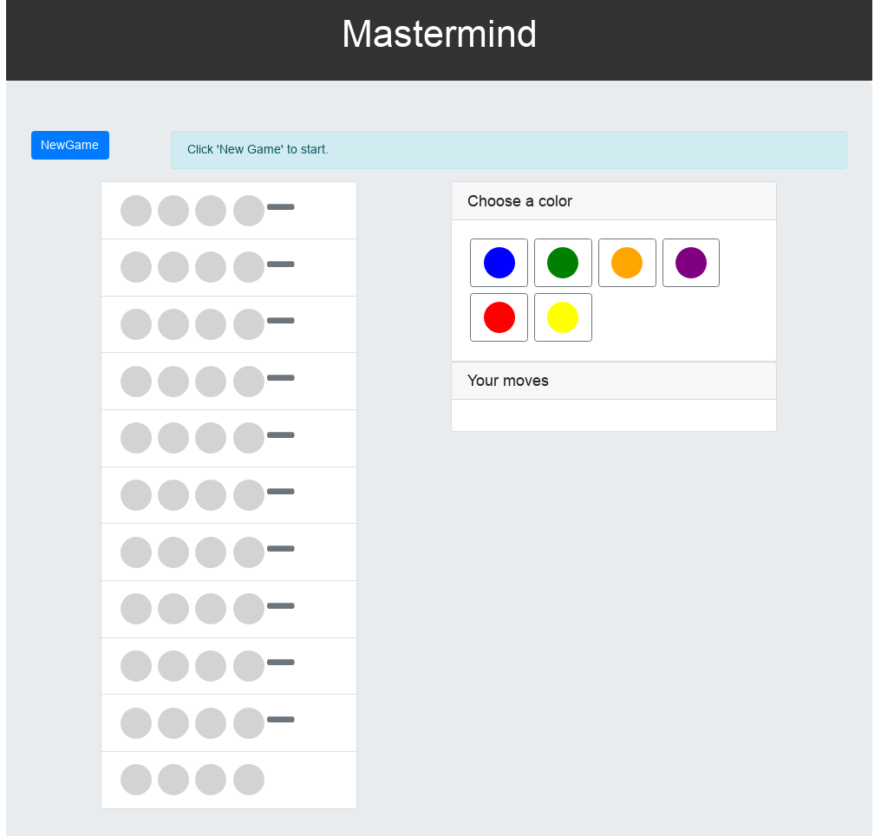
React: Mastermind
Mastermind
ControlPanel
CodePeg
CodeResult
ColorButton
CodePhrase
History
Board

Slide 20
React: Mastermind
Mastermind
Board
Control Panel
History
ColorButton
CodePhrase
CodePeg
CodePeg
CodeResult

Slide 21
React: Mastermind
CodePeg: a Stateless component
import React from 'react'
const CodePeg = (props) =>
<div className={"codepeg-" + props.color + " rounded-circle"} />
export default CodePeg

Slide 22
React: Mastermind
What is a pure function?
A function is pure if:
Its output depends only on its input(s)
Has same output for same input(s)
Produce no side effects
Notes:
Unlike in imperative languages, a function in Haskell is really a function, just as mathematicians intended it to be. To distinguish it from cheap imitations, Haskell functions are sometimes called pure functions. Here are the fundamental properties of a pure function:
A function returns exactly the same result every time it's called with the same set of arguments. In other words a function has no state, nor can it access any external state. Every time you call it, it behaves like a newborn baby with blank memory and no knowledge of the external world.
A function has no side effects. Calling a function once is the same as calling it twice and discarding the result of the first call. In fact if you discard the result of any function call, Haskell will spare itself the trouble and will never call the function. No wonder Haskell has a reputation for laziness (more about it later).
One of the major strengths of Haskell is that the execution of pure functions can be easily parallelized because they have no side effects. With no side effects there are no data races -- the bane of parallel programming.

Slide 23
React: Mastermind
CodeResult: a Stateless component
import React from "react"
import { Glyphicon } from "react-bootstrap"
const CodeResult = (props) =>
<div className="d-flex">
<Glyphicon glyph={get_glyph(props.result)} className={get_style(props.result)} />
</div>
export default CodeResult

Slide 24
React: Mastermind
Helper function
const get_glyph = (result) => {
let glyph = "minus"
if (true === result) {
glyph = "ok"
} else if (false === result) {
glyph = "remove"
}
return glyph
}

Slide 25
React: Mastermind
Should stateless components hold helper functions?
NO, stateless component shouldn’t do anything but display!
-> What about duplicated code when calling them?
YES, then there is only one place to manage things
-> What about reusability?

Slide 26
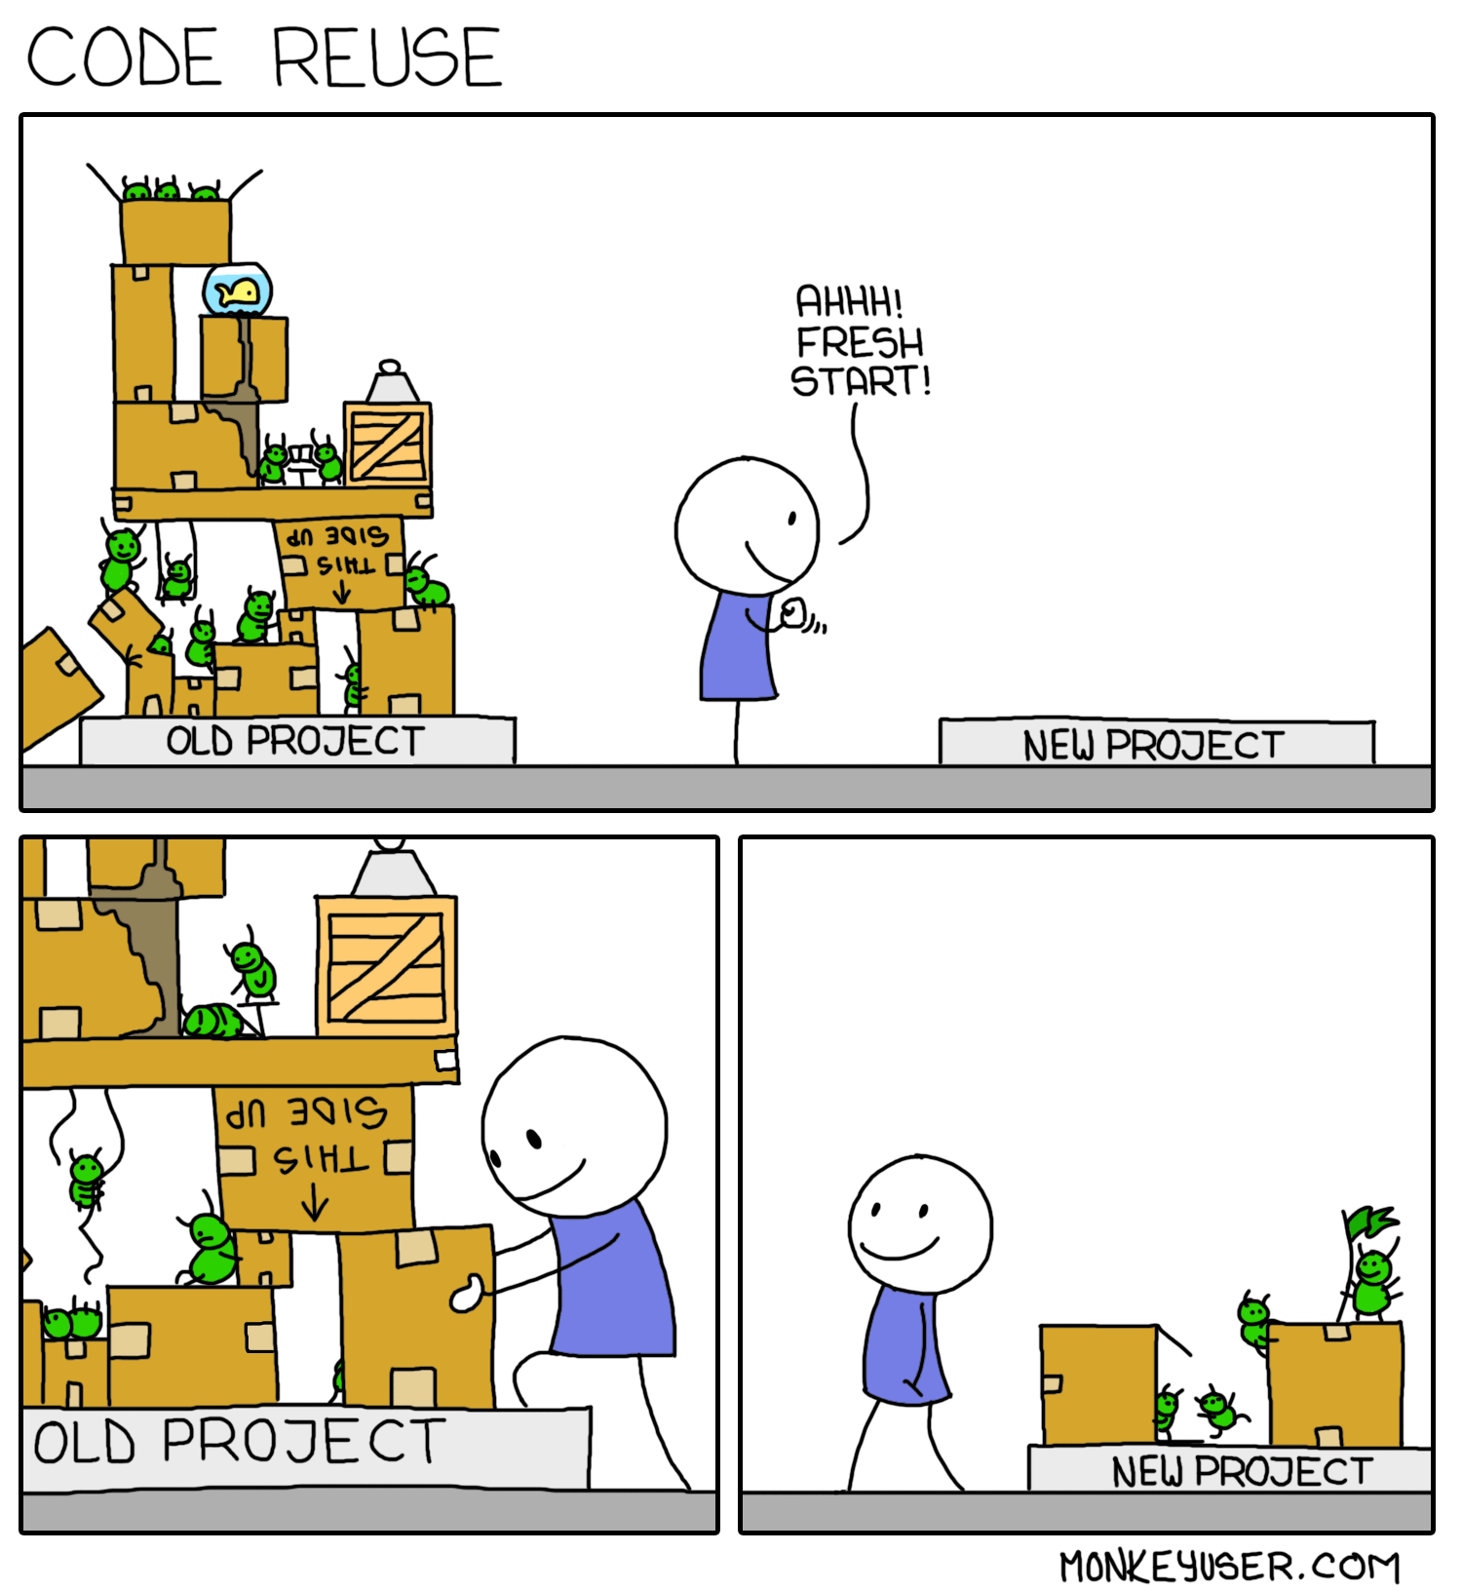
React: Mastermind

Slide 27
React: Mastermind
How ColorButton is called
const AVAILABLE_COLORS = ["blue", "green", "orange", "purple", "red", "yellow"]
<Panel.Body>
{AVAILABLE_COLORS.map(
(av_color, index) => <ColorButton
key={index}
color={av_color}
onClick={() => this.choose_color(av_color)} />
)}
</Panel.Body>

Slide 28
React: Mastermind
Mastermind: a stateful component
class Mastermind extends React.Component {
constructor(props) {
super(props)
const nbMaxTries = 10
this.state = {
"nbMaxTries": nbMaxTries,
"breakerTries": this.init_breaker_tries(nbMaxTries),
"tryResults": this.init_try_results(nbMaxTries),
"codeToBreak": this.init_code_to_break(nbMaxTries),
"currentTryIndex": 0,
"currentColorChoice": 0,
"gameState": START,
"history": [],
"historyIndex": 0
}
}

Slide 29
React: Mastermind
State management in JS + React
init_breaker_tries(nbMaxTries) {
return Array(nbMaxTries).fill(null).map(_unused => ["grey", "grey", "grey", "grey"])
}
Why not this?
init_breaker_tries(nbMaxTries) {
return Array(nbMaxTries).fill( ["grey", "grey", "grey", "grey"])
}
> let a = Array(2).fill(["grey", "grey"])
[["grey", "grey"], ["grey", "grey"]]
> a[0][0] = "blue"
[["blue", "grey"], ["blue", "grey"]]

Slide 30
React: Mastermind
State management in JS + React
let breakerTries = this.state.breakerTries
let currentTryIndex = this.state.currentTryIndex
let currentColorChoice = this.state.currentColorChoice
let gameState = this.state.gameState
breakerTries[this.state.currentTryIndex][this.state.currentColorChoice] = color
currentColorChoice++
if (currentColorChoice === 4) {
if (this.check_try(currentTryIndex)) {
return true
}
currentColorChoice = 0
currentTryIndex++
}
if (currentTryIndex === (this.state.nbMaxTries)) {
gameState = LOST
}

Slide 31
React: Mastermind
State management in JS + React
this.setState({
"breakerTries": breakerTries,
"currentColorChoice": currentColorChoice,
"currentTryIndex": currentTryIndex,
"gameState": gameState
})
this.save_history()

Slide 32
React: Mastermind
setState :
ensures that you don’t edit your state directly… but still you can edit your this.state
when it’s invoked, React merges data, and calls render()
Is asynchronous
Notes:
Changing a state value in your code like this this.state.name= 'new name' won’t do any good. It won’t trigger a re-render and a possible real DOM update, which we want. For the most part, changing state directly without setState is an anti-pattern and should be avoided.

Slide 33
React: Mastermind
State management in JS + React
this.setState({
"breakerTries": breakerTries,
"currentColorChoice": currentColorChoice,
"currentTryIndex": currentTryIndex,
"gameState": gameState
})
this.save_history()

Slide 34
React: Mastermind
State management in JS + React
save_history() {
let state = JSON.parse(JSON.stringify(this.state))
state.history.push({
"breakerTries": state.breakerTries,
"tryResults": state.tryResults,
"gameState": state.gameState
})
this.setState({
history: state.history,
historyIndex: state.historyIndex + 1
})
}

Slide 35
React: Mastermind
Data change without mutation!
Benefits:
Tracking changes
Optimizing re-rendering
Easier Undo / Redo / Time travel implementation

Slide 36
React: Mastermind
Data Flow
State initialization
State update
Stateful Component
Event
state.x
state.y
Stateless Component
Stateless Component
Event
Event (i.e please update state)
state.y.z
Stateless Component

Slide 37
React: Mastermind
Data Flow
state initialization
state update
state2 initialization
state2 update
Stateful Component
Event
Stateful Component
Event
state.x
state.y
state2.x
state2.y
Stateless Component
Stateless Component
Event
Event
Stateless Component
Stateless Component
Event
Event
state.y.z
state2.y.z
Stateless Component
Stateless Component

Slide 38
React: Mastermind
Data Flow
state initialization
state update
state2 initialization
state2 update
Stateful Component
Event
Stateful Component
Event
state.x
state.y
user.name
state2.y
Stateless Component
Stateless Component
Event
Event
Stateless Component
Stateless Component
Event
Event
user.name
state2.y.z
Stateless Component
Stateless Component

Slide 39
React: Mastermind
Data Flow
state initialization
state update
state2 initialization
state2 update
Stateful Component
Event
Stateful Component
Event
state.x
state.y
state.y
state2.x
state2.y
Stateless Component
Stateless Component
Event
Event
Stateless Component
Stateless Component
Event
Event
state.y.z
state2.y.z
Stateless Component
Stateless Component

Slide 40
React: Mastermind
File architecture
HTTP request
Session
3rd party
...
Stateful Component
Event
props
props
Stateless Component
Stateless Component
Event
props
Event
Stateless Component

Slide 41
React: Mastermind
File architecture
|_components
|_ ComponentA.js
|_ ComponentB.js
|_ utils
|_ UtilA.js
|_ UtilB.js
|_css
|_ index.css

Slide 42
React: Mastermind
File architecture
|_components
|_ componentA
|_ ComponentA.jsx
|_ componentA.css
|_ helpers.js
|_ componentB
|_ ComponentB.jsx
|_ componentB.css
|_ helpers.js
|_ common
|_ commonA.js
|_ commonB.js

Slide 43
React: Conclusion
Data safety:
Stateless component are pure functions
State is considered “immutable”
Clean data flow:
No 2-way data binding
“Immutable” state ensures data safety
State updates are easily findable

Slide 44
React: Conclusion
Scalability:
Reusable component

Slide 45
React: Conclusion
BUT

Slide 46
React: Conclusion
JS is not designed for immutability
JS is not typed
Architecture: many possible implementations
Data Flow: many possible implementations

Slide 47






React: Conclusion
Third parties at the rescue!

Slide 48

React
Why not used a typed functional language instead?

Slide 49
Javascript + React

Slide 50
Reason +
Javascript + React

Slide 51
ReasonML: History
ReasonML:
Created by Jordan Walke (Facebook)
Born in 2016
Current version: 3.0.4 (2017/12/09)

Slide 52
ReasonML: What is this?
ReasonML is a language:
Powered by Ocaml (80% of Ocaml works), means:
Functional (impure)
typed
Designed for JS developers
Compiled to JS

Slide 53
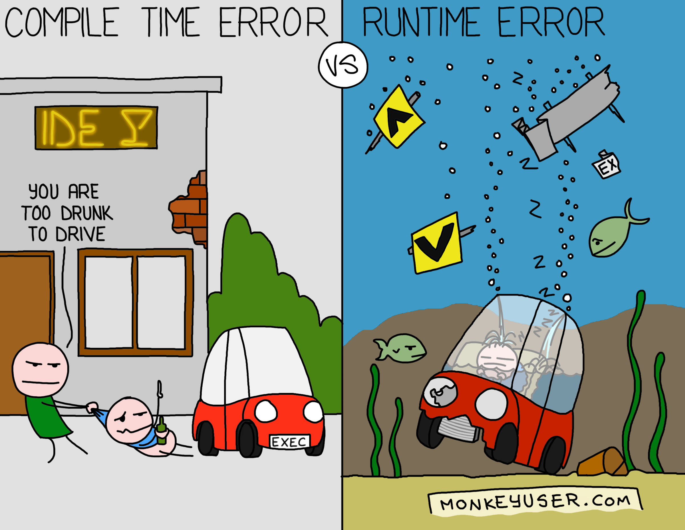
ReasonML: What is this?
What are the benefits of the compiler?

Slide 54
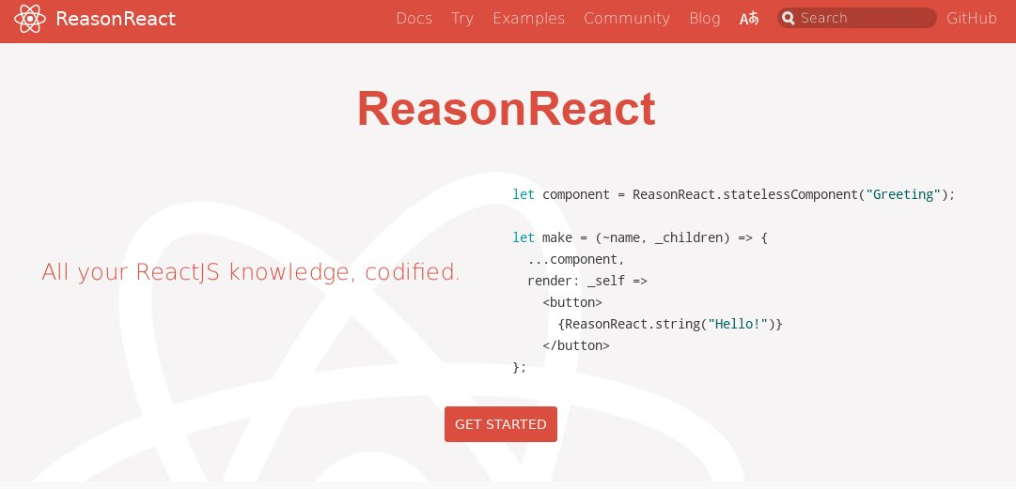
ReasonML: use React

Slide 55
ReasonReact: From JS to Reason
Remember our stateless component
import React from 'react'
const CodePeg = (props) =>
<div className={"codepeg-" + props.color + " rounded-circle"} />
export default CodePeg

Slide 56
ReasonReact: From JS to Reason
First thing first: types
type pegColor =
| Blue
| Green
| Grey
| Orange
| Purple
| Red
| Yellow;

Slide 57
ReasonReact: From JS to Reason
A stateless component
let codePeg = ReasonReact.statelessComponent("CodePeg");
let to_color = (color: pegColor) =>
switch (color) {
| Blue => "blue"
| Green => "green"
| Grey => "grey"
| Orange => "orange"
| Purple => "purple"
| Red => "red"
| Yellow => "yellow"
};
let make = (~color, _children) => {
...codePeg,
render: _self =>
<div className=("codepeg-" ++ to_color(color) ++ " rounded-circle") />,
};

Slide 58
ReasonReact: From JS to Reason
Remember state definition
class Mastermind extends React.Component {
constructor(props) {
super(props)
const nbMaxTries = 10
this.state = {
"nbMaxTries": nbMaxTries,
"breakerTries": this.init_breaker_tries(nbMaxTries),
"tryResults": this.init_try_results(nbMaxTries),
"codeToBreak": this.init_code_to_break(nbMaxTries),
"currentTryIndex": 0,
"currentColorChoice": 0,
"gameState": START,
"history": [],
"historyIndex": 0
}
}

Slide 59
ReasonReact: From JS to Reason
Types… again
type pegColor =
| Blue
| Green
| Grey
| Orange
| Purple
| Red
| Yellow;
type gameState =
| Start
| Try
| Lost
| Win;

Slide 60
ReasonReact: From JS to Reason
Types... again
type breakerTry = {
pegs: array(pegColor),
result: option(bool),
};
type state = {
nbMaxTries: int,
breakerTries: array(breakerTry),
codeToBreak: breakerTry,
currentTryIndex: int,
currentColorChoiceIndex: int,
gameState,
history: array(history),
historyIndex: int,
};

Slide 61
ReasonReact: From JS to Reason
Now our stateful component
let mastermind_component = ReasonReact.reducerComponent("Mastermind");
let init = () => {
nbMaxTries: 10,
breakerTries: initBreakerTries(10),
codeToBreak: initBreakerTry(),
currentTryIndex: 0,
currentColorChoiceIndex: 0,
gameState: Start,
history: [||],
historyIndex: 0,
};
let make = _children => {
...mastermind_component,
initialState: init,
reducer: reduce,
render: self =>
<JSX_style_code>
}

Slide 62
ReasonReact: From JS to Reason
Event management: remember ReactJS
const AVAILABLE_COLORS = ["blue", "green", "orange", "purple", "red", "yellow"]
<Panel.Body>
{AVAILABLE_COLORS.map(
(av_color, index) => <ColorButton
key={index}
color={av_color}
onClick={() => this.choose_color(av_color)} />
)}
</Panel.Body>

Slide 63
ReasonReact: From JS to Reason
Event management: Types….. Again and again
type action =
| NewGame
| ChooseColor(pegColor)
| GoToHistory(int);

Slide 64
ReasonReact: From JS to Reason
Event management
<div className="card-body">
(
ReasonReact.array(
Array.mapi(
(idx, color) =>
<ColorButton
key=(string_of_int(idx))
color
onClick=(_event => self.send(ChooseColor(color)))
/>,
enumChoosablePegColors(),
),
)
)
</div>

Slide 65
ReasonReact: From JS to Reason
Finally: manage state
let reduce = (action, state: state) =>
switch (action) {
| NewGame => new_game(state)
| ChooseColor(color) => choose_color(state, color)
| GoToHistory(historyIndex) => go_to_history(state, historyIndex)
};

Slide 66
ReasonReact: Conclusion
SO WHAT’S BETTER THAN IN ITS JS COUNTERPART?

Slide 67
ReasonReact: Conclusion
Type system
+
Real Immutable type
=
SAFE DATA

Slide 68
ReasonReact: Conclusion
Data safety / Data flow:
Explicit events
Redux-like already implemented
Really functional (curry, composition, etc.)
Compiler!
Explicit side effects

Slide 69
React: Conclusion
Scalability:
Reusable component

Slide 70
ReasonReact: Conclusion
BUT

Slide 71
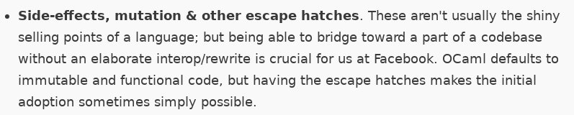
ReasonReact: Conclusion
From: https://reasonml.github.io/docs/en/what-and-why.html

Slide 72
React: Conclusion
Architecture: many possible implementations
No need to think about data modelization!

Slide 73
ReasonReact: Conclusion
let copy_breakerTries = breakerTries =>
Array.map(
bt => {pegs: Array.copy(bt.pegs), result: bt.result},
breakerTries,
);

Slide 74
ReasonReact: Conclusion
Remember this? Isn’t it smelly?
type breakerTry = {
pegs: array(pegColor),
result: option(bool),
};
type state = {
nbMaxTries: int,
breakerTries: array(breakerTry),
codeToBreak: breakerTry,
currentTryIndex: int,
currentColorChoiceIndex: int,
gameState,
history: array(history),
historyIndex: int,
};

Slide 75
Reason +
Javascript + React

Slide 76
Reason +
Javascript + React
Elm

Slide 77
Elm: History
Elm:
Created by Evan Czaplicki
Born in 2012
Current version: 0.18(2016/11/14)

Slide 78
Elm: What is it?
Elm is a language:
Functional (pure)
Statically typed
Compiled to JS

Slide 79
Elm: What is it?
Elm is a language:
Functional (pure)
Statically typed
Compiled to JS

Slide 80
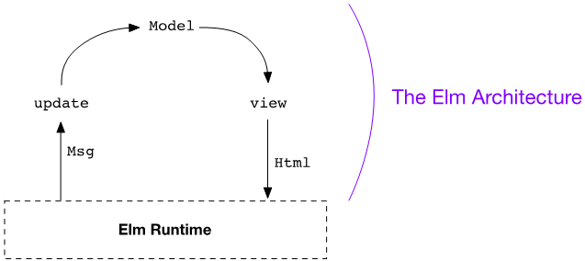
Elm: What is it?

Slide 81
Elm: What is it?
OH WAIT...

Slide 82

Elm: What is it?

Slide 83
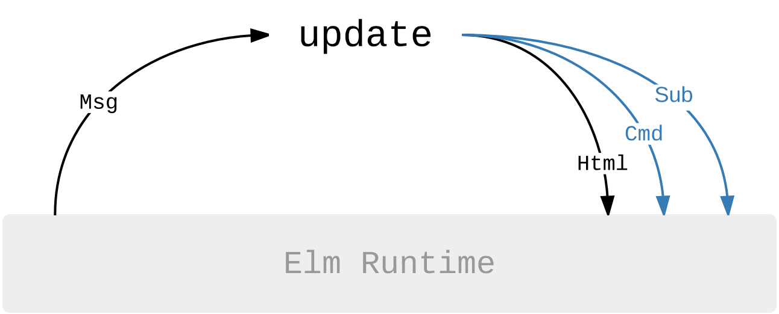
Elm: What is it?

Slide 84
Elm: TEA
main =
Html.programWithFlags
{ init = init
, view = view
, update = update
, subscriptions = subscriptions
}

Slide 85
Elm: TEA
init: (Model, Cmd Msg)
update: Msg -> Model -> (Model, Cmd Msg)
view: Model -> Html Msg
subscriptions: Model -> Sub Msg

Slide 86
Elm: Mastermind
Remember this? Isn’t it smelly?
type breakerTry = {
pegs: array(pegColor),
result: option(bool),
};
type state = {
nbMaxTries: int,
breakerTries: array(breakerTry),
codeToBreak: breakerTry,
currentTryIndex: int,
currentColorChoiceIndex: int,
gameState,
history: array(history),
historyIndex: int,
};

Slide 87

Elm: Mastermind

Slide 88
Elm: Mastermind
type alias BreakerTry =
{ pegs : ZipperList PegColor
, result : Maybe Bool
}
type alias CodeToBreak =
List PegColor
type alias History =
ZipperList (ZipperList BreakerTry)
type alias Model =
{ breakerTries : ZipperList BreakerTry
, codeToBreak : CodeToBreak
, gameState : GameState
, randomSeed : Random.Seed
, history : History
}

Slide 89
Elm: Mastermind
ZipperList?
type alias ZipperList item =
{ previous : List item
, current : item
, next : List item
}
---
Therefore, the complete list of items is: `previous ++ [current] ++ next`

Slide 90
Elm: Mastermind
Event management
type Msg
= NewGame
| ChooseColor PegColor
| MoveHistory Int

Slide 91
Elm: Mastermind
Init state
init : Flags -> ( Model, Cmd Msg )
init flags =
{ breakerTries = initBreakerTries
, codeToBreak = List.repeat 4 Grey
, gameState = Start
, randomSeed = Random.initialSeed flags.initSeed
, history = ZipperList.init initBreakerTries []
}
! []

Slide 92
Elm: Mastermind
Init state
initBreakerTries : ZipperList BreakerTry
initBreakerTries =
ZipperList.init initBreakerTry <|
List.repeat (nbMaxTries - 1)
initBreakerTry
initBreakerTry : BreakerTry
initBreakerTry =
{ pegs = ZipperList.init Grey <| List.repeat 3 Grey
, result = Nothing
}
initHistory : History
initHistory =
ZipperList.init initBreakerTries []

Slide 93
Elm: Mastermind
State update
update : Msg -> Model -> ( Model, Cmd Msg )
update msg model =
case msg of
MoveHistory step ->
let
func =
if step > 0 then
ZipperList.forward
else
ZipperList.back
history =
List.foldl (\_ acc -> func acc) model.history <|
List.range 0 ((abs step) - 1)
in
{ model
| breakerTries = ZipperList.current history
, history = history
}
! []

Slide 94
Elm: Mastermind
View
view model =
Grid.container []
[ CDN.stylesheet
, header [ class "app-header" ]
[ h1 [ class "text-center title" ] [ text "Mastermind" ]
]
, Grid.container [ class "jumbotron" ]
[ viewControlPanel model.gameState
, Grid.row []
[ Grid.col [ Col.md1 ] []
, Grid.col [ Col.md4 ]
[ viewBoard model.breakerTries model.codeToBreak
]
, Grid.col [ Col.md1 ] []
, Grid.col [ Col.md5 ]
[ viewColorChooser model.gameState
, viewHistory model.gameState model.history
]
, Grid.col [ Col.md1 ] []
]
]
]

Slide 95
Elm: Mastermind
LET THE ARCHITECTURE / PATTERN EMERGE!

Slide 96
Elm: Conclusion
Strict architecture
Let the architecture / pattern emerge
Strict data flow
Scalable
Think about your data
Compiler!

Slide 97
Elm: Conclusion
BUT

Slide 98
Elm: Conclusion
Not backed by big company (even if MS, Amazon, etc use it internally)
JS interoperability!

Slide 99

This is a useless slide
Its only goal is to make the next
The 100th

Slide 100


Thank you

